Slide 1
SIG WEBSITE PROJECT
SnapPapers Team:
Ramsha Naeem
Harsh Sanjaykumar Pandya
Alejandro Santoscoy Rivero
Sithija Wijesinghe

Slide 2
FEATURES
Homepage
Login Page
Profile Page
Create and Update Profile
Bookmark profiles
Visualization page
Wordcloud ( Based on the research tags
Explore Researcher Page
Explore Papers
Notes:
GeoLocations (Based on the Location of the university)

Slide 3
What have we been working on
Landing Page
Login Page
Profiles
Individual Profile Pages
Explore Profiles
Visualization page
Trends based on the number of paper published
Researcher map
Contact Us
Notes:
GeoLocations (Based on the Location of the university)

Slide 4
DEMO
SIG Website

Slide 5
What comes next?
Profiles
Editing and Updating Profile Data
Data Visualization Dynamics
Searching capabilities for researchers (Research Interest)
Bilingual

Slide 6

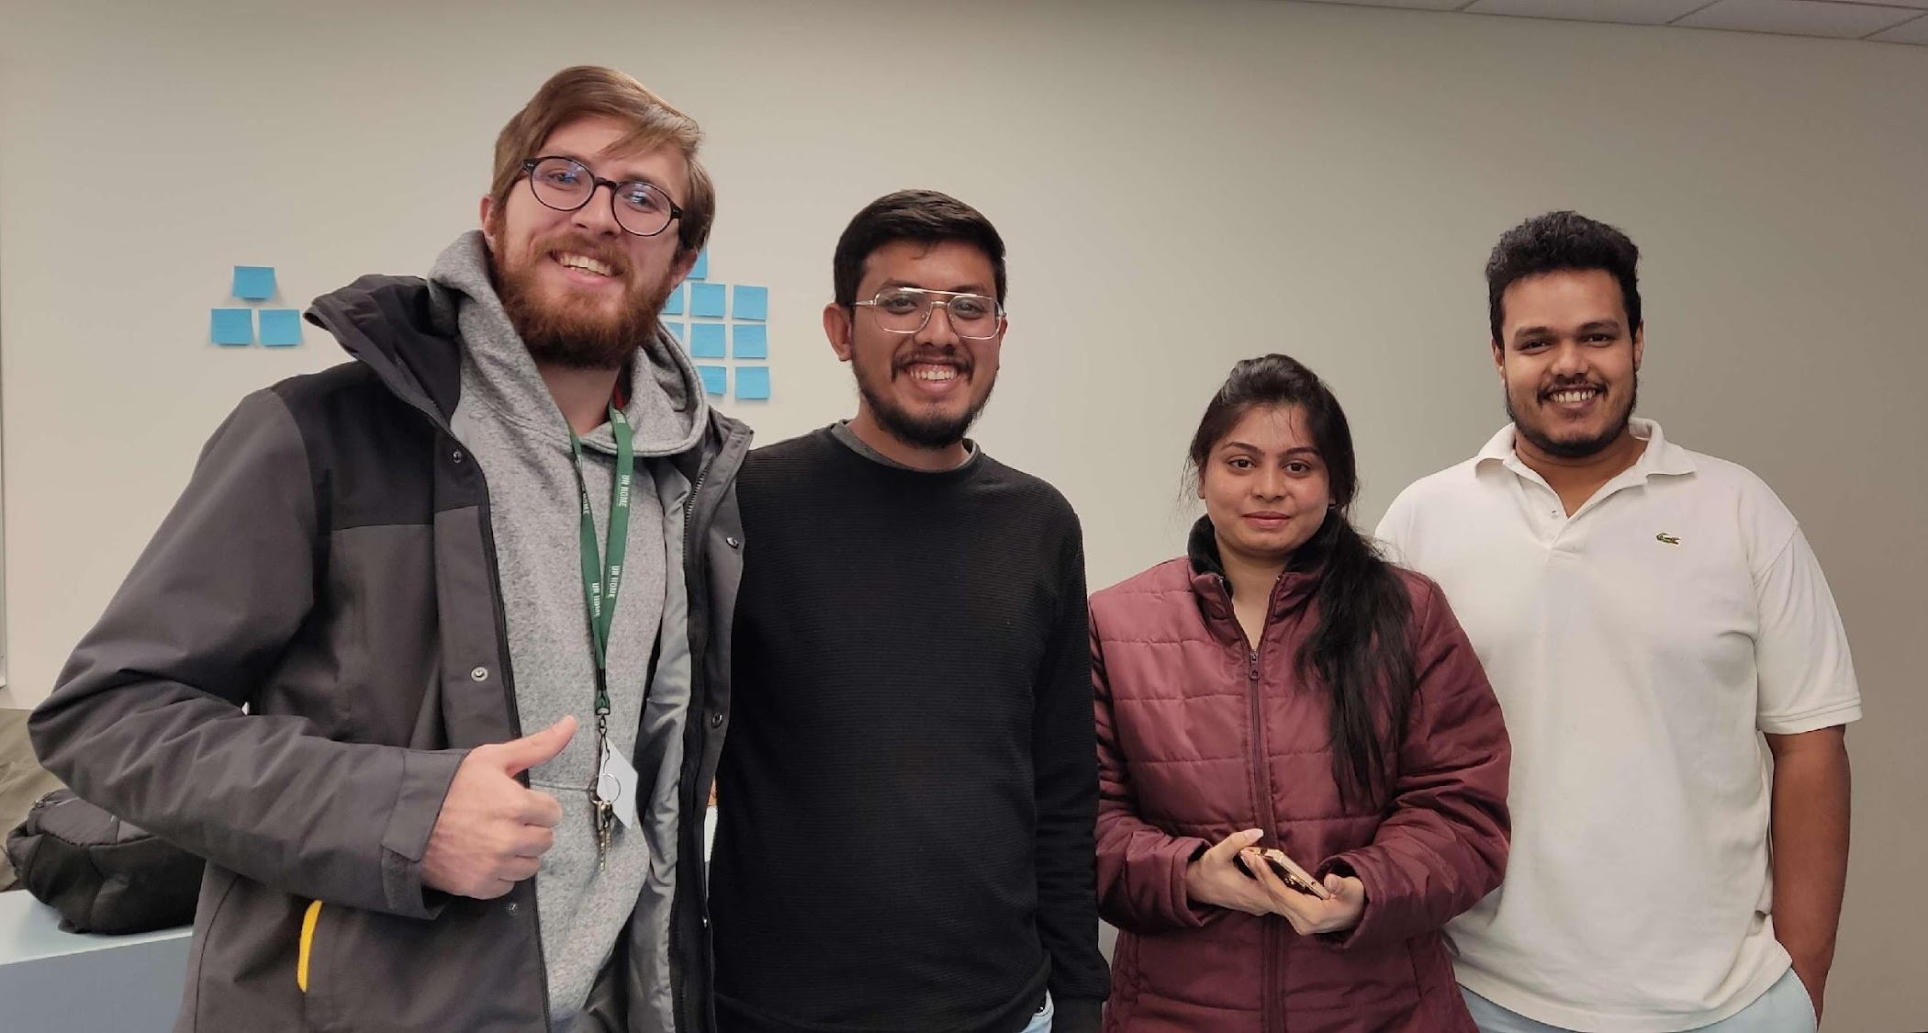
THANK YOU VERY MUCH!
SnapPapers

Slide 7
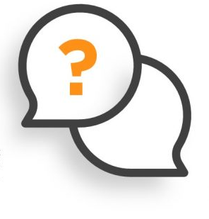

QUESTIONS & ANSWERS

